Slide 1
ASUF VISION AND POLICY APPROACH TOWARDS EMPLOYMENT AND LABOUR RELATIONS IN THE AGRICULTURAL SECTOR
Dr John Purchase
Cape Agri Employer’s Organisation (CAEO)
9 June 2014

Slide 2
For today……..
Does organised agriculture now have a ‘united front’?
Does ASUF have consensus positions on strategic issues affecting agriculture?
Could ASUF now negotiate with one voice with the government, other stakeholders and the international community?
What does ASUF’s planned social compact with the government and labour on social issues entail?

Slide 3
Dualism in the agricultural sector
Commercial agricultural sector on the one hand:
- comprises ~40 000 farming units and predominantly white-owned,
but increasingly new entrant black farmers.
- produces around 95% of all agricultural produce on freehold land.
- characterised by open, competitive market system,
and totally integrated and exposed to the global market.
- Global competitiveness of value chains thus required to survive
and ensure commercial/business sustainability.
- Scale of economy, productivity and business intelligence of
paramount importance.
- Sustainable from triple bottom-line perspective?

Slide 4
Dualism in the agricultural sector
Smallholder and subsistence farming sector:
- Smallholder farmers number ~200 000, and predominantly black.
- Primarily located in former homeland areas, comprising ~14
million hectares of agricultural land.
- Agricultural conditions complex, including tenure security issues,
poor infrastructure, land degradation, skills development issues,
constrained access to finance, technology and markets, etc.
- Subsistence farmers number ~ 2,0 million households, mostly
gardening for own consumption, ensuring basic level
of nutrition and limiting household expenditure.

Slide 5
Questions arise:
How do we create more and better opportunities for especially smallholders and new entrants to access competitive commercial value chains?
Can ASUF, through its organized agriculture member organizations, play a role in bridging this dualism?
Dualism developed from policy interventions and development backlogs, and must thus be corrected through policy and development initiatives.
However, policy interventions must be supportive of a market approach to agriculture and must not impact negatively on confidence, investment and production.
The way in which land restitution has been implemented is a case in point as in most cases it placed the development of land in limbo, with a resultant drop in production. Is this the way to address dualism? Are those communities interested in farming? What’s the cost? Who provides support?
Co-operative approach required to leverage off scale of economy benefits so as to ensure viability.
Managerial inputs and skills required.
Greater symbiosis between commercial and smallholder farmers. Training and mentorship opportunities important. Mechanization circles.
Possible government support through soft loans, etc.

Slide 6
Message…….
Dualism a reality that needs to be bridged. NDP, by and large, provides reality and direction.
Must create more and better opportunities for smallholders and new entrants to participate and compete in commercial value chains.
Producers and agribusinesses can and must contribute alike, but government policy development and support essential in a broader Public-Private Partnership.
ASUF’s vision and strategic intent reflect the reality of dualism, but much more than that, ASUF has positioned itself to
- pro-actively bridge that dualism and,
- serve the broader agricultural sector.

Slide 7


Slide 8
ASUF Declaration of Intent
Strategic Intent
Establish a united voice for the common interests of the broader agricultural sector in order to promote and grow the South African agricultural sector.
Vision
A united , prosperous and sustainable agricultural sector in South Africa

Slide 9
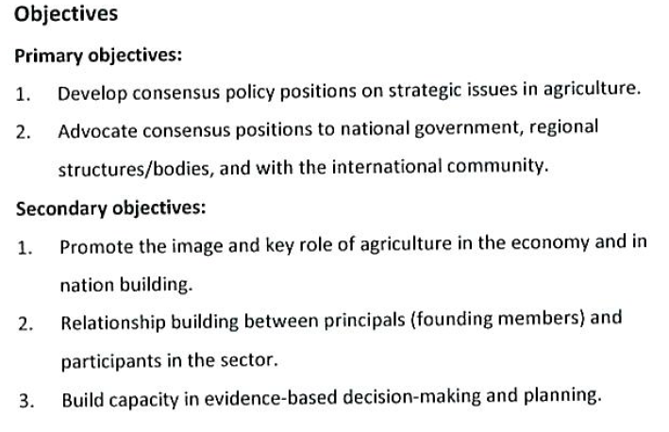
ASUF Declaration of Intent

Slide 10
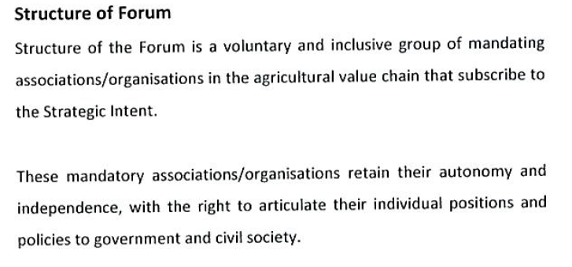
ASUF Declaration of Intent

Slide 11
For today……..
Does organised agriculture now have a ‘united front’?
Does ASUF have consensus positions on strategic issues affecting agriculture?
Could ASUF now negotiate with one voice with the government, other stakeholders and the international community?
What does ASUF’s planned social compact with the government and labour on social issues entail?

Slide 12
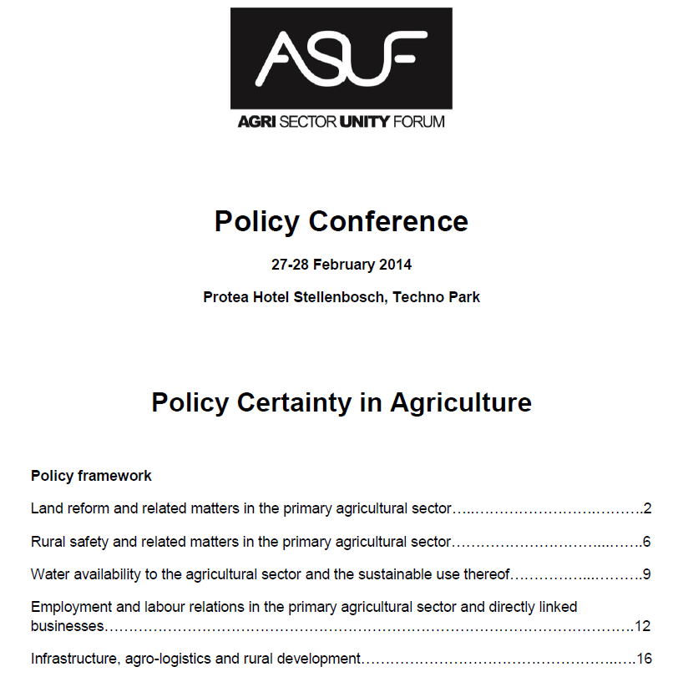
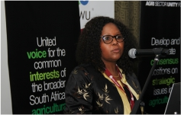
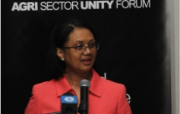

Slide 13
Reasons for joint position on labour
There are more than 600 000 workers involved in the commercial farming sector who along with household members are relying on the economic wellbeing of the sector for their livelihoods. This figure is an official figure from Stats SA, but does not include farm workers/labourers working outside the formal commercial agricultural sector.
The remuneration of farm workers amounts to approximately R13 billion per annum – about 8% of gross income and 26% of net income in the primary agricultural sector. This emphasizes the importance of wage agreements, productivity considerations, labour legislation and general labour relations on the economic sustainability of the sector.
Farming communities can be regarded as inter- and intra-dependent socio-economic units requiring, with a view to rural stability, a broader approach - than merely labour relations - in terms of social matters like schools, housing, security of tenure, funeral arrangements, etc.

Slide 14
Reasons for joint position on labour (Cont.)
As clearly expressed in government’s overarching policy document, the National Development Plan, as well as in other policy documents, employment creation, alleviation of poverty and rural development still hinge on the agricultural sector, the current trend of decreasing employment should be reversed.
Labour unrest, as was experienced in 2012, led to consequences not conducive towards furthering national policy objectives, nor to healthy labour relations and the sustainability of the agricultural sector.

Slide 15
Ethical conduct towards labour
ASUF will uphold the following value system in engaging with farm workers in the workplace or with respect to social considerations:
Labour legislation is to be complied with by all employers. It is expected that legislation take full and objective cognisance of the peculiar situation pertaining to social and economic realities in the agricultural sector at large and subsectors in particular. ASUF will work towards a conducive and legislative policy environment for agriculture and agribusiness.
Although minimum wages are prescribed, farm workers are acknowledged as deserving of decent employment conditions and wages based on negotiations between employers and employees, if minimum wages are to be exceeded.
Farm workers are full participants in the economy of the country and the perception that farmworkers are a vulnerable grouping should be addressed.

Slide 16
Ethical conduct towards labour (Cont.)
No worker shall be unfairly discriminated against based on race, age, gender, pregnancy, marital status, family responsibility, disability, ethnic or social origin, colour, sexual orientation, religion, HIV-status, conscience, belief, political opinion, culture, language, birth or trade union membership.
No worker shall be subjected to harassment or abuse.
Reasonable access to farms on the basis of a generally agreed to modus operandi should be allowed. Access to graves will be based on the generally accepted protocol.
A working environment that is safe and without any risk to the health of employees, save for those risks which are inherent to a specific position, will be promoted.
Off-farm housing with a view to sustainable tenure security will be promoted as the preferred option, whilst good quality on-farm housing will be strived for if the preferred option (i.e. off-farm housing) is not achievable or viable.

Slide 17
Ethical conduct towards labour (Cont.)
ASUF will ensure that its members understand the AgriBEE Sector Codes with a view to transformation.
Members of ASUF will explore all possible options to enhance skills and literacy of farm workers, also within the context of a greater demand for specialised skills.
All farm workers should have access to health services and related education.
Individual farmers will be encouraged to provide sport and/or recreational facilities to their workers, where it is within their means and reasonably possible to do so.
Child labour will not be condoned.
Farm workers should also be able to access insurance and retirement schemes.
Excellence should be acknowledged and rewarded.

Slide 18
Operational matters to be addressed
Sectoral determination and minimum wages in particular have in recent times come about largely on an ad hoc basis. This should be formalised within the context of applicable legislation and agreed to engagement between stakeholders.
A social compact needs to be developed that also indicates to what extent economic conditions faced by the agricultural sector, be it input cost pressure, depressed market prices or competition in the value chain, impact on employment and employment conditions.
A protocol on joint action and co-operation, with a view to dealing with labour related matters, should be investigated to inter alia avoid unprotected strikes.
Clear guidelines should be devised with respect to the permanent or temporary inclusion of foreign workers into the local labour force – related administrative matters like obtaining corporate permits for foreign workers should also be ironed out.

Slide 19
Operational matters to be addressed (Cont.)
ASUF will support a study to be conducted under the auspices of the ILO into the living and working conditions of farm workers, as well as into labour relations and compliance with applicable legislation in the agricultural sector and related industries.
ASUF will embark on a facilitation process with relevant organisations, including government, to provide practical guides and information to employers and employees on rights and obligations in terms of applicable legislation.
ASUF will participate in government processes and specifically portfolio committee engagement on labour legislation, such as the Labour Relations Act.

Slide 20
For today……..
Does organised agriculture now have a ‘united front’?
Does ASUF have consensus positions on strategic issues affecting agriculture?
Could ASUF now negotiate with one voice with the government, other stakeholders and the international community?
What does ASUF’s planned social compact with the government and labour on social issues entail?

Slide 21
ASUF Engagement
Labour
- Sectoral determination: Minister Mildred Oliphant
- 3X meetings with Deputy President and various Ministers
through ‘Vulnerable Workers Forum’. New DP approach?
- Section 77 application by COSATU at NEDLAC on the ‘Lack
of Transformation in the Agriculture Sector’.
- International Labour Organisation (ILO) Study
Water
- National Water Resource Strategy Vers. 2 (NWRS2)
Land
- ‘Strengthening the relative rights of those people working the
Land’
- ‘The Agricultural Landholding Policy’
Safety & Security
ONLY ON CONSENSUS MATTERS

Slide 22
For today……..
Does organised agriculture now have a ‘united front’?
Does ASUF have consensus positions on strategic issues affecting agriculture?
Could ASUF now negotiate with one voice with the government, other stakeholders and the international community?
What does ASUF’s planned social compact with the government and labour on social issues entail?

Slide 23
Framework Agreement / Social Compact
Deputy President call for Framework Agreement at National Level between Industry, Labour and Government.
In principle agreement from ASUF.
New Deputy President already approached on his position.
Developments by Fruit SA certainly step in right direction, as is ‘Laborie dialogue’ and other initiatives to improve labour relations in general and in the Western Cape in particular.
Framework Agreement living document and development process requires commitment and delivery from all parties.

Slide 24
Framework Agreement / Social Compact
What should such a Framework agreement entail?:
Preamble
Guiding principles
Roles and commitments
Ensuring rule of law, peace and stability
Strengthening Labour Relations
Roadmap for Future Work
Communication
Declaration by Stakeholders
Implementation at National, Provincial and Municipal Level will be critical.

Slide 25
Take home message….
ASUF has made very significant progress, but much still to be done.
Untimely passing of Chairperson, Ms Ntombi Msimang, a huge loss and setback.
Debate in ASUF on way forward: Indaba on 8 July.
Meeting request with Minister Senzeni Zokwana – positive response received and meeting being set up.
Next 5 years will be extremely challenging and require cool heads and fortitude.
However, we can make the transition successfully if we all play our part………..

Slide 26
Thank you

