Slide 1
A review of Research and emerging strategy around Farm worker housing in the cwdm
Dr Rick de Satge
Phuhlisani NPC
Kaapse Agri Werkgewersorganisasie HR Workshop
Stellenbosch
29th March 2017

Slide 2
Research and strategy objectives
Improved integration of farm worker housing, service and tenure security needs in municipal housing strategies.
Development of a supportive policy environment; innovative partnerships and institutional arrangements to enable farm worker housing, service and tenure security needs to be progressively met in the Cape Winelands.
Research and social dialogue leading to deeper understanding of the housing, services and tenure issues in and across localities
Measures agreed to practically address the need for improved farm worker housing, access to services and tenure security on and off-farm
Proposals for policy review

Slide 3
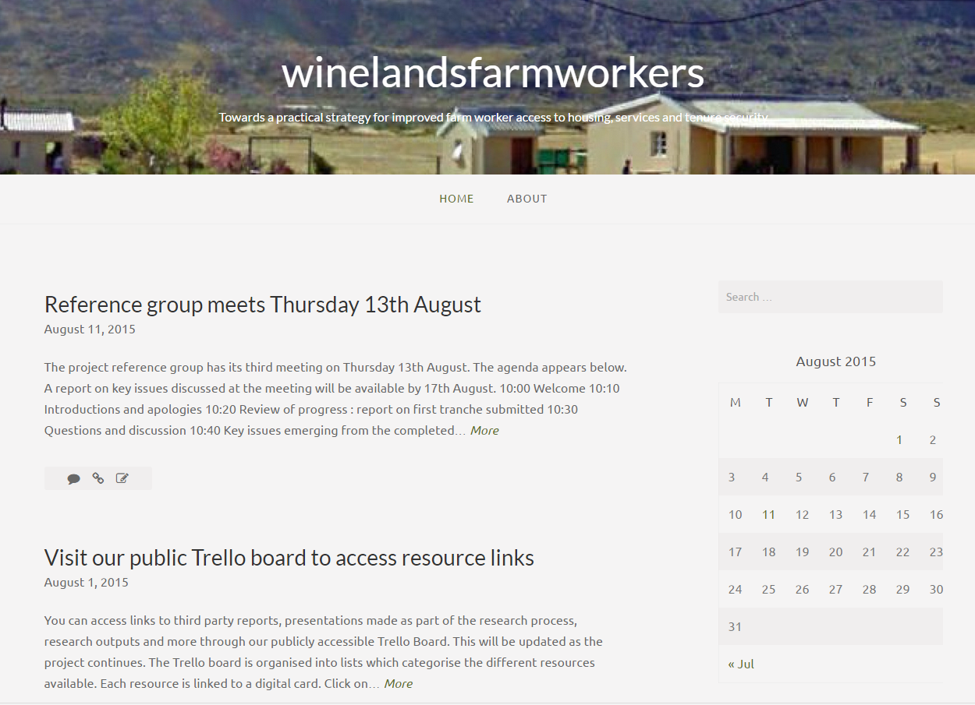
All research publicly available www.winelandsfarmworkers.net

Slide 4
Research and strategy development in CWDM
A literature review – collating existing knowledge
Research in five case areas
A social platform for a District conversation
Learning journeys to examine issues on the ground
A draft strategy
Online dissemination and review
Practical strategy and policy proposals
Research report backs
Reference group oversight
Constant Communication

Slide 5
Research conducted
We completed a total of 224 interviews
  72 workers living on farms
  82 workers living off farms
  14 representatives of NGOs and Unions
  25 individual producers
  4 representatives of organised agriculture
  10 Councillors
  11 Municipal officials
  2 representatives of provincial departments
  2 representatives of WIETA and SIZA
  2 other key informants

Slide 6
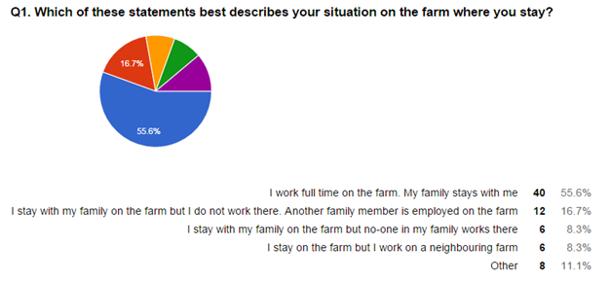
Workers on farms
71 interviews recorded
  15 interviews in the Breede Valley
  12 interviews in Langeberg
  15 in Witzenberg
  15 in Drakenstein
  14 in Stellenbosch
A variety of living circumstances
A variety of circumstances
Above half – 55.6% or 40 respondents - worked full time on the farm and had their family staying with them.
Twelve respondents – 16.7% - stayed on the farm where a household member was employed, but did not work there.
Six stayed on the farm and no one in their household worked on the farm.
Six respondents – 8.3% stayed on one farm but worked on a neighbouring farm.

Slide 7
Workers off farm
A total of 82 interviews were conducted with off-farm workers across the study area. These included:
  20 in Stellenbosch
  17 in Drakenstein
  15 in Breede Valley
  15 in Langeberg
  15 in Witzenberg
The respondents were roughly split between seasonal and permanent employees on farms
  a small percentage – 9.9% - being contracted by a labour broker and working on many different farms.

Slide 8
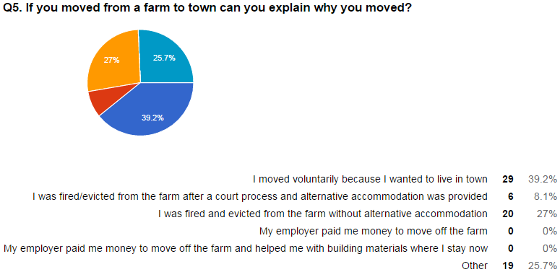
Reasons for the move from farm to town
Voluntary relocation 39.2%
Of the 71 respondents answering this question 31 (43.6%) reported that they had been evicted off-farm. (These include 7 respondents who answered reported being evicted under ‘Other’)
Respondents report that only 8.1% of these evictions took place following a legal process and with alternative accommodation being provided

Slide 9
Off-farm workers perceptions of the main reason for eviction
Changing farm owners was thought to be the most common reason for eviction.
This correlates to the trend of farm consolidation identified in the literature review as a factor driving evictions.
Social problems are also a significant contributing reason for evictions.

Slide 10
Twenty five producers
A total of twenty-five producers responded to an online questionnaire.
The online questionnaire was publicised on www.winelandsfarmworkers.net and distributed through Agri Weskaap and local farmers associations.
The link to the questionnaire was also made available through a newsletter which was distributed by the Cape Agri Employers’ Association to its members.

Slide 11
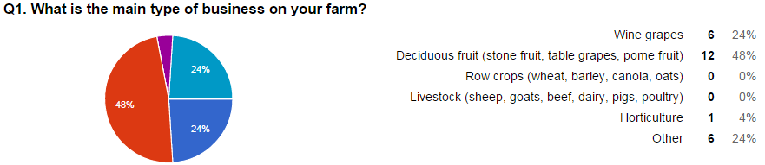
Main type of business on the farm
The majority of the respondents were involved in deciduous fruit and wine grape production consistent with production trends within the district.

Slide 12
Key economic and regulatory challenges
Rising input, fuel, packaging and labour costs and associated inflation
The increase in the minimum wage and the mounting wage bill
The rising cost of energy,
The cost of housing provision and infrastructure maintenance
The high capital expenditure required to provide housing and services on farms
The eviction of former employees dismissed following disciplinary action
The occupation of on-farm housing by people without the employer’s consent
The occupation of houses by adult members of the family who do not work on the farm
High dependency ratios
  One respondent reported a total of more than 250 people staying on the property, yet only seven permanent workers were employed
The high compliance burden associated with, labour and tenure legislation, BEE, StatsSA etc
The generally low productivity of agricultural labour

Slide 13
Key economic and regulatory challenges
Low levels of education amongst farm workers
Problems associated with intergenerational poverty and alcohol dependence
Theft
The low prices of wine
Farmers being price takers rather than price setters
The demands of supermarkets and the high costs of certification to access export markets and the lack of government support for producers to explore new markets
The impact of the new visa regulations on wine farm tourism
Inadequate state support for crop losses due to hail damage and other courses
The mounting risks associated with climate change
The assertion that uncertainties over land reform constrained the development of the agricultural market - in particular the proposed redistribution of farm land on a 50-50 basis

Slide 14
Assessment of key factors impacting on farming business
Labour legislation
  84% of producers interviewed identified labour legislation as having a significant impact on their businesses.
  Producer comments indicate a distinction between the content of legislation and the cost of compliance requirements associated with its implementation.
Tenure
  76% of producers interviewed highlighted tenure legislation as being of either high or critical significance.
Water scarcity
  72% of the producers identified mounting water scarcity as a factor of high or critical significance impacting on their farming business
Farm worker settlement policy
  68% of individual producers interviewed identified the lack of agreed policy for farm worker settlement as being of high or critical significance to the farming business.
  This was linked to the lack of state support and subsidies for on-farm housing and the perceived inappropriateness of the existing farm resident housing policy within the housing code.

Slide 15
Assessment of key factors impacting on farming business
Minimum wages
  62% of the producers interviewed indicated that the sectoral determination on the minimum wage was a factor of high or critical significance
  28% of producers in interviewed regarded it as being of medium or low significance.
These differentiated perspectives may reflect the relative labour intensity of various farming activities and the number of employees qualifying for a wage increase

Slide 16
Assessment of key factors impacting on farming business
Deregulation and global competition
  60% of respondents identified deregulation of the agricultural sector and global competition as being either of high or critical significance.
  Individual comments above also highlight a commonly expressed view of producers as price takers whose businesses are negatively affected by low commodity prices and the competitive advantage of other producer countries which received greater state support.
Skilled labour
  56% of producers interviewed identified the shortage of skilled agricultural labour as a factor of high or critical significance.
Climate change
  Only 12% of respondents deemed climate change to be of critical significance.
  60% of respondents deemed climate change to be of medium that manageable significance or low significance.

Slide 17
Changing management practices
96% of respondents highlighted that they had made changes in farm management practice.
Their responses can be grouped into intersecting three clusters
Cluster 1 combines mechanisation, casualisation coupled with cuts in investment in farm housing and services
  I did not build any extra housing. I made more use of temporary employees. I transport more temporary workers in town on a daily basis
  I have less workers than three years ago and make use of more machines. I tried to get more skilled workers as they are more productive
  Permanent workers have been reduced in favour of seasonal workers. Housing has become the employee’s own responsibility
  I have made more use of mechanisation and employing more seasonal workers (mainly black women from townships). No more houses are being built. In fact, I demolished farm worker houses.
  We have made the move to less permanent labour and more seasonal labour. We now collect seasonal staff from the local town. We intend to move to sourcing more of our staff off farm since the minimum wage does not allow one to deduct the real cost of supplying housing.
  Due to legislation [our] permanent workforce has been reduced. Due to legislation [our] management style is more formal and admin intensive. Use of contractors has increased. We have become hesitant to supply housing for workers.

Slide 18
Changing management practices
Cluster 2
The middle ground seems to focus on more human resource management approaches and strategies designed to improve worker productivity, value for money and to ensure legislative compliance. This often means that a farmer will employ an HR consultant to advise on labour management and cost containment practices.
  A 50% hike in the minimum wages over three years has meant that less people could be employed. Labour equates to 60% of input costs. Therefore, a sharp increase in wages has to lead to drastic measures on the farms to absorb this cost
  We have focused on the output of all workers because of high costs and employ a smaller permanent workforce
  Doen eers goeie navorsing alvorens aanstellings gemaak word. Hanteer die werkers meer klinies soos by professionele besighede. Werknemers word vergoed vir wat hul werd is en daar word nie meer net uitgedeel nie
  I implemented performance reviews for my workers and awarded remuneration increases accordingly
  I took on a non-white farm manager and employed an increasing number of women as full-time permanent employees

Slide 19
Changing management practices
Cluster 3: A third strategy linked to expanding businesses seems to prioritise on-farm empowerment and increased investment to meet the needs of farmworkers
  We shifted and changed management positions with a very positive impact
  More permanent personnel had been placed in management positions. We have improved on current housing – rebuilding and we are implementing more skills training.
  We have empowered general farm workers to do the supervising, irrigation and managing of seasonal worker teams. Two management houses on farm are now being used to house these supervisors.
  We have invested in a lot of services for our employees – a crèche, clinic sports fields community hall, etc
  Farmworkers have been engaged in management and decision-making.
  Housing has been upgraded with running water and electricity and toilets have been upgraded to prescribed specifications by the municipality.

Slide 20
Problem statement
No functional on-farm state housing support
  1994 Housing White Paper acknowledged that farm workers effectively excluded from state subsidy scheme as secure tenure was rarely achievable
  Section 4 of ESTA requires that the Minister shall grant subsidies for on and off site developments
    However very few Section 4 subsidies approved
    A view in the DLA/DRDLR that ESTA unimplementable
  A Policy for the Settlement of Farm Workers in the Western Cape was prepared and gazetted in 2000 to promote the vision that all farm workers “must be able to be settled permanently” and to create “on the farm” and “off the farm” settlement options including agri-villages and agri-suburbs.
    The policy was mothballed and has never been implemented

Slide 21
Problem statement
The Rural Foundation discontinued in late 1990’s
  Partnership between industry and the state
  No champion for farm worker issues
The Farm Residents Housing Assistance Programme was introduced in 2009
    Not a single subsidy applied for or approved since introduction
    Why? Programme imposes conditions on farm owners which they regard as onerous
    Programme never reviewed or evaluated by DHS
  No state support provided for on farm retirement housing for farm workers
  Tax rebates for investment in on farm housing withdrawn
Farm residents do not enjoy access to free basic services

Slide 22
Problem statement
The rise in the minimum wage puts the combined income of many farm worker households above the R3500 subsidy threshold
  Pushes them into the FLISP band
  Very few options available in the gap housing market
  High levels of indebtedness and poor credit records pre-empt eligibility for housing finance
Increasing casualisation and externalisation of farm labour
  Research indicates that majority of farm residents are not registered on housing demand data base
  Some are hesitant to register as they see this could be a prelude to displacement or eviction
  Movement off farm is increasingly negotiated/financially induced
    Once farm workers live off-farm there is nothing to distinguish them from other citizens in informal settlements requiring shelter and services

Slide 23
A perfect storm
Overall a combination of economic trends and a persistent policy vacuum can be argued to have created a perfect storm.
The three spheres of government appear to be pulling in different directions on the farm worker question.
Departments with responsibilities to improve conditions and protect rights on farms lack agreed strategy and common programmes.
Farmers are forced to find ways to cut costs and reduce dependence on labour through casualisation and mechanisation.
SARS tax rebates and interest rate discounts offered by the Land Bank incentivising farmers to invest in housing and social services have been withdrawn without any viable alternative being put in place.

Slide 24
A perfect storm
Increasing numbers of households are being displaced off farms.
Once off farm they become the responsibility of already stretched municipalities.
The consequence is the expansion of poorly serviced informal settlements on the periphery of small towns and mounting concentrations of people living in poverty who are reliant on social grants and precarious seasonal work.
Where municipalities provide emergency housing for evicted or displaced farm workers this creates enormous social tensions locally, as residents of the town who have been on waiting lists for years allege ‘queue jumping’.

Slide 25
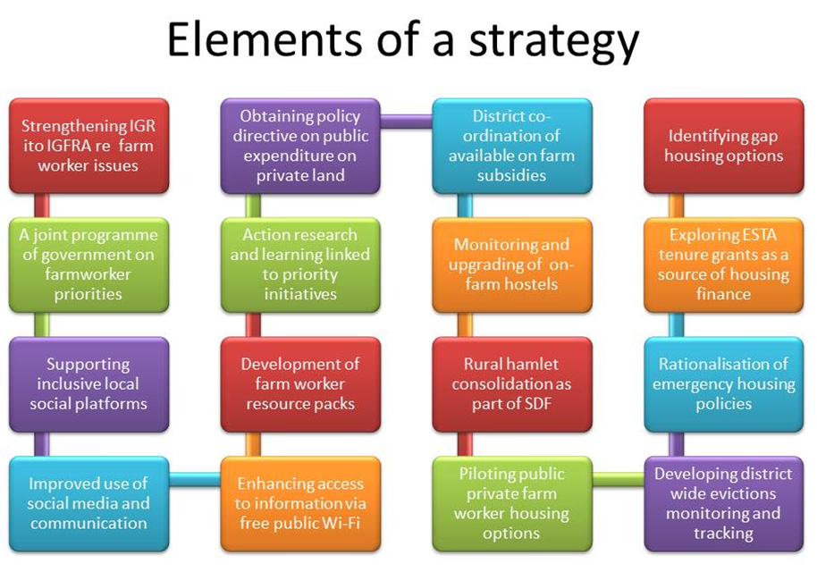

Slide 26
Policy impacts
Further research for the Laborie Dialogue Initiative
Processes to link and support existing SDI initiatives as part of a joint ETI, LEP UCT and Phuhlisani Initiative
Upcoming summit on “Partnerships for Human Settlements” organised by Department of Human Settlements in Western Cape.
  The summit started out as being focused entirely on farm worker housing
  Recently focus of the Summit shifted to Employer-Assisted Housing.
  Housing for farmworkers incorporated within this framework

Slide 27
In search of a champion
We require fresh thinking on creative ways to expand agricultural social investment programmes and enable alternative service delivery models.
In this regard the Laborie report reviews the history of the Rural Foundation (established in the 1980s and disbanded in the late 1990’s) which some analysts regard as contributing to a “golden age of service delivery on farms”.
While acknowledging that the Foundation had its flaws, the report asks whether it is not time to reimagine a 21st century version with substantial industry investment, active union and worker involvement, NGO and state support.
Such an initiative could help generate the energy to break the policy gridlock and to plan and implement practical programmes to help restore the citizenship rights and dignity of farm workers.

