Slide 1

Menslike Hulpbron Konferensie / Human Resources Conference
Presented by Steph Grobler (US: Bed, BedH, LLB)
Litigation Department: Evictions: ESTA/PIE

Slide 2
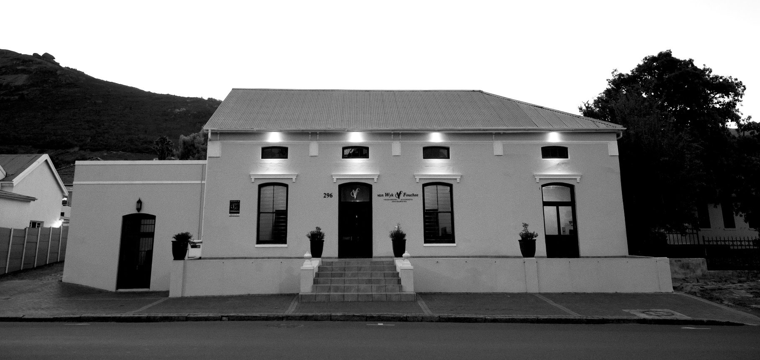
Established 1995 Situated @ 296 Main Road, Paarl.

Slide 3
General Practice Areas
Commercial Law
Property Law
Litigation
Taxation
Trust Services
Sport Law
Debt Recovery
Family Law
Public Benefit Organisations

Slide 4
Areas waar ons Litigeer / Service Areas where we Litigate
Drakenstein Munisipaliteit: Paarl, Wellington, Tulbagh, Saron
Breede Valley Munisipaliteit: Worcester, De Doorns
Witzenberg Munisipaliteit: Ceres, Wolseley
Stellenbosch Munisipaliteit: Stellenbosch, Franschoek, Kylemore, Klapmuts
City of Cape Town Munisipaliteit: Durbanville, Strand, Kuilsrivier
Bergrivier Munisipaliteit: Porterville, Piketberg
Swartland Munisipaliteit: Moreesburg, Malmesbury
Cederberg Munisipaliteit: Citrusdal, Clanwilliam
Theewaterskloof Munisipaliteit: Caledon, Grabouw, Villiersdorp
Langeberg Munisipaliteit: Montague, Ashton, Robertson, McGregor, Bonnievale

Slide 5
HOLISTIC APPROACH TO CASE MANAGEMENT
EVICTIONS
Dynamic Area of Law
Historical Background
Political Climate +
Agendas
External Challenges faced by Farmers
Constitutional Rights
Socio-Economic
Just and Equitable Factors

Slide 6
EVICTIONS: PIE/ESTA
Litigation: Magistrate & High Court, including
Land Claims Court experience
Urgent Eviction Applications/Interdicts and Protection from Harassment Orders
Consultations/Opinions
Housing/ Rental Agreements
- Compliance ESTA/PIE
Referrals to and from Labour Consultants
Settlement Agreements/Relocations
Cost Implications

Slide 7
ESTA: AGRICULTURAL LAND
PIE: URBAN LAND
Occupier ito “ESTA” means:
The person that concluded the agreement (oral/written consent) with the owner/person in charge to reside on the land.
In the event there is a written housing agreement the family of the occupier will not be considered “occupiers” but “family members”. If no agreement is in place family members could acquire actual/tacit consent through the presumptions in ESTA.
Occupier ito “PIE” means:
A person (squatter / occupier) occupying without consent (tacit/actual) on the land (urban/ agriculture -where income exceeds the prescribed amount ito the Regulations in ESTA).

Slide 8
ESTA: PLAAS GROND
PIE: DORPSGROND
Okkupeerder in terme van ESTA” beteken:
Die persoon wat aanvanklik met die grondeienaar of persoon in beheer ŉ ooreenkoms (mondelings / skriftelike toestemming) aangegaan het om op die grond (slegs plaasgrond) te woon.
In die geval waar daar ŉ skriftelike behuisingsooreenkoms is kwalifiseer die familielede / assosiate nie as okkupeerders in terme van ESTA nie. In die geval waar daar nie ŉ skriftelike behuisingsooreenkoms is nie kan die familielede/ assosiate stilswyende/ uitdruklike toestemming soos omskryf in ESTA bekom.
Okkupeerder by “PIE” beteken:
ŉ Persoon (plakker / onregmatige okkupeerder) wat sonder enige toestemming (stilswyend / uitdruklike) op die grond (dorpsgrond / plaasgrond- waar die inkomste van die okkupeerders meer is as die voorgeskrewe bedrag soos omskryf in ESTA) kom woon het.

Slide 9
Regulations of ESTA, 1997. REGULATION 2
2. (1) The prescribed amount for the purposes of paragraph (c) of the definition of “occupier” in section 1(1) of the Act shall be an income of R5 000 per month.
2) For the purposes of sub-regulation (1) “income” means –
a. a person’s gross monthly cash wage or salary; or
b. where a person earns money –
i. other than in the form of a monthly cash wage or salary, the average monthly amount of such person’s gross earnings during the immediately preceding year; or
ii. in addition to a monthly cash wage or salary, such person’s gross monthly cash wage or salary together with the average monthly amount of such person’s additional gross earnings during the immediately preceding year:
provided that remuneration in kind shall not be taken into account.’
As prescribed by the Minister in 1997 , predicted amendment shortly.

Slide 10
Categories of Occupiers
8(2); 8(3) Occupiers: nexus between occupier and owner/person in charge / employment agreement
8(1) Occupiers - Family Members occupying
Presumption of Tacit/Actual Consent: esp. if no contract/agreement
8(4) occupiers: Protected Occupiers
8(5) occupiers: Dependents of 8(4) Occupiers

Slide 11
PROCEDURE: ESTA
PROCEDURE: PIE
Letter of Cancellation
- Formal service by Sheriff
30 days / time specified in housing agreement.
Application: Founding Affidavit.
Sec 9(2)(d): 02 Month Notification to Occupiers, Municipality, Department of Land and Rural Development.
First Court Date: 2 months after service
Occupiers Present: Legal Representation
Opposing Affidavit; Replying Affidavit.
Meaningful Engagement.
Probations Officers Report.
Duration: 12 – 18 months.
Automatic Review to LCC
Where does appeal lie?: Snyders v De Jager
* Estimate Costs: R30 000.00 – R50 000.00 and if settled approximately R15000.00
Letter of Cancellation
- Formal service by Sheriff
30 days / time specified in housing agreement.
Application for Eviction: Ex Parte Order
- Founding Affidavit
First court date 14 days after service.
Opposing Affidavit.
Replying Affidavit.
Meaningful Engagement only in certain circumstances.
Duration: 3-6 months.
*Estimate Costs: R8000.00 – R20 000.00.

Slide 12
PROSEDURE: ESTA
PROSEDURE: PIE
Verblyfbeëindigingsbrief.
- Formele betekening deur Balju.
30 dae / tyd aangedui in `n behuisingsooreenkoms.
Aansoek: Funderende Verklaring.
Art 9(2)(d): 02 Maande kennisgewing aan Okkupeerder/s, Munisipaliteit, Departement van Landelike Ontwikkeling en Grondhervorming.
Eerste hofdatum.
Indien Okkupeerders teenwoordig.
Opponerende Verklarings; Repliserende Verklarings.
Betekenisvolle Samesprekings.
Proefbeampte Verslag.
Tydsduur: 12 – 18 maande.
Outomatiese Hersiening na Grondeisehof
Appel: Snyders v De Jager
Kostes: R30 000.00 – R50 000.00 en indien geskik word ongeveer R15000.00.
Verblyfbeëindigingsbrief.
- Formele betekening deur Balju
30 dae / tyd aangedui in `n behuisingsooreenkoms.
Aansoek om Uitsetting: Ex Parte Bevel
- Funderende Verklaring
Eerste hofdatum 14 dae na betekening.
Opponerende Verklaring.
Repliserende Verklaring.
Betekenisvolle Samesprekings slegs in sekere omstandighede.
Tydsduur: 3-6 maande.
Kostes: R8000.00 – R20 000.00.

Slide 13
Settlement / Relocation
Informal: Pre-litigation
Formal: At any time during the litigation process
Settlement Negotiations: Proposals pertaining to alternative accommodation / cash settlement
Settlement Agreement: Court Order / Eviction Order
Section 8(4) occupiers: Settlement options
Ex Parte / Unopposed Application WCHC to make a settlement agreement an order of court
Relocations: Formal Housing Alternative -Agri Village / Off Site Developments

Slide 14
SUGGESTIONS FOR LABOUR CONSULTANTS
Housing Agreements: Compliant with ESTA and current case law
- annual revision of agreements
Signing Agreements: Both head of household and spouse/life partner signs housing agreement
If consent given to family member: agreement in writing
If “inslaapfooi” negotiated: reduced to writing with particular occupier
If matter referred to CCMA, try to finalise immediately by way of settlement agreement
NB: Agreement at CCMA to Vacate Premises / settlement for alternative accommodation not enforceable in terms of ESTA.

Slide 15
SUGGESTIONS FOR LABOUR CONSULTANTS
Advise client to formally cancel occupation rights (served by sheriff)
- Cancellation of all possible rights in household
Avoid informal settlement agreements
Formalise settlement agreements / get an attorney involved to ensure rights / interests of land owner protected
Refer matters to attorney immediately if income of occupier exceeds R5000 per month
In preparation for a referral of an eviction
- See questionnaires
NB: full history & records of employment relationship, disciplinary process, internal hearings, CCMA hearings, Labour Court

Slide 16
Dynamic Area of Law
For example:
ESTA Amendment Bill: Proposed amendments to ESTA 2015
Regulation of Agriculture Land Holdings Bill : 17 March 2017 – proposes to prevent foreign ownership of agriculture land
Political referendums/agendas: underlying issue of land redistribution

Slide 17
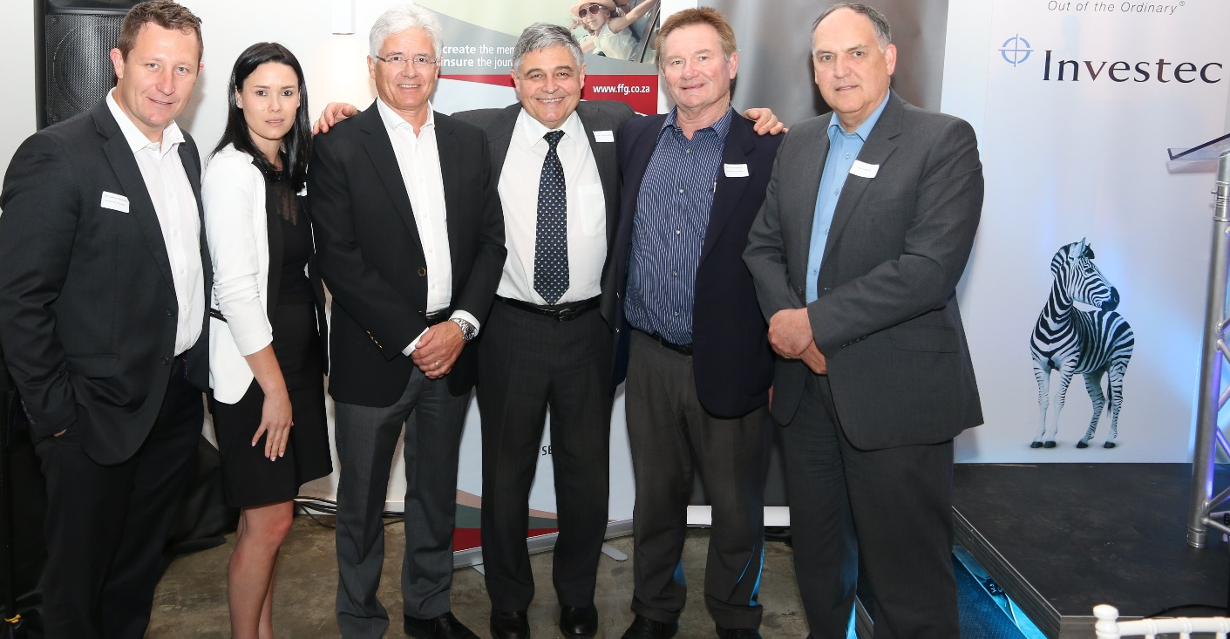
Agri Seminar: Hosted by VWF on 20 October 2016
FROM LEFT TO RIGHT: Willem van Heerden, Steph Grobler, Adv Henk Havenga (SC), Adv Pieter Oosthuizen (Tax, US), Anville van Wyk

Slide 18

Agri Seminar: All proceeds donated to agri-social development
FROM LEFT TO RIGHT: Johan Duran (Valley of Abundance], Counc. Rita Andreas and Willem van Heerden (VWF)

Slide 19
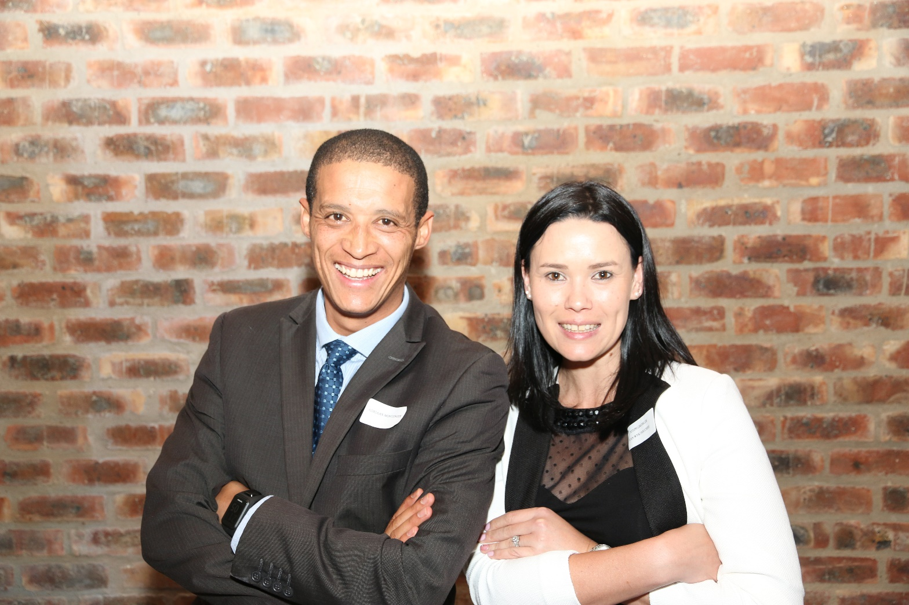
Litigation Team

